Slide 1

INTRO TO R and RStudio INTERFACE
Session 15

Slide 2

R
R: A language and environment for statistical computing.
R Foundation for Statistical Computing, Vienna, Austria. URL
https://www.R-project.org/
R is an integrated suite of software facilities for data manipulation, calculation and graphical display. It includes:
an effective data handling and storage facility,
a suite of operators for calculations on arrays, in particular matrices,
a large, coherent, integrated collection of intermediate tools for data analysis,
graphical facilities for data analysis and display either on-screen or on hardcopy, and
a well-developed, simple and effective programming language which includes conditionals, loops, user-defined recursive functions and input and output facilities.
Notes:
Why take this course?
1. Very useful statistical package – one of the best. Used for advanced analytics, business intelligence and predictive analytics
2. Everybody collects data and statistical packages help to process the wealth of information.
3. SAS is used in: medical research institutions, academic institutions, pharmaceutical industry, financial institutions, etc.

Slide 3

R
R is a language and environment for statistical computing and graphics. It is a GNU project which is similar to the S language and environment which was developed at Bell Laboratories (formerly AT&T, now Lucent Technologies) by John Chambers and colleagues.
R first appeared in about 1993, and its first release publicly was in 1995.
It is a free, open-source software.
Rstudio is an IDE (integrated development environment) and GUI (graphical user interface) for R. It’s produced by a private corporation, which also produces enterprise versions of R and R studio for profit. Rstudio is a free, open source software. We’ll implement R from this interface almost exclusively in the class
Notes:
Why take this course?
1. Very useful statistical package – one of the best. Used for advanced analytics, business intelligence and predictive analytics
2. Everybody collects data and statistical packages help to process the wealth of information.
3. SAS is used in: medical research institutions, academic institutions, pharmaceutical industry, financial institutions, etc.

Slide 4
Learning objectives:
Develop competence in using the R studio interface and identifying relevant menus options and tools contained therein.
follow best practices for reproducibility, documentation and annotation of statistical analysis code and scripts
Explain the basic principle of functional programming
Introduction to R/Rstudio interface
Interface
programming structure
rules
R help
Notes:
Lecture SAS is a statistical package and a programming language. As with any language quite a bit of practice is required in order to be fluent.

Slide 5
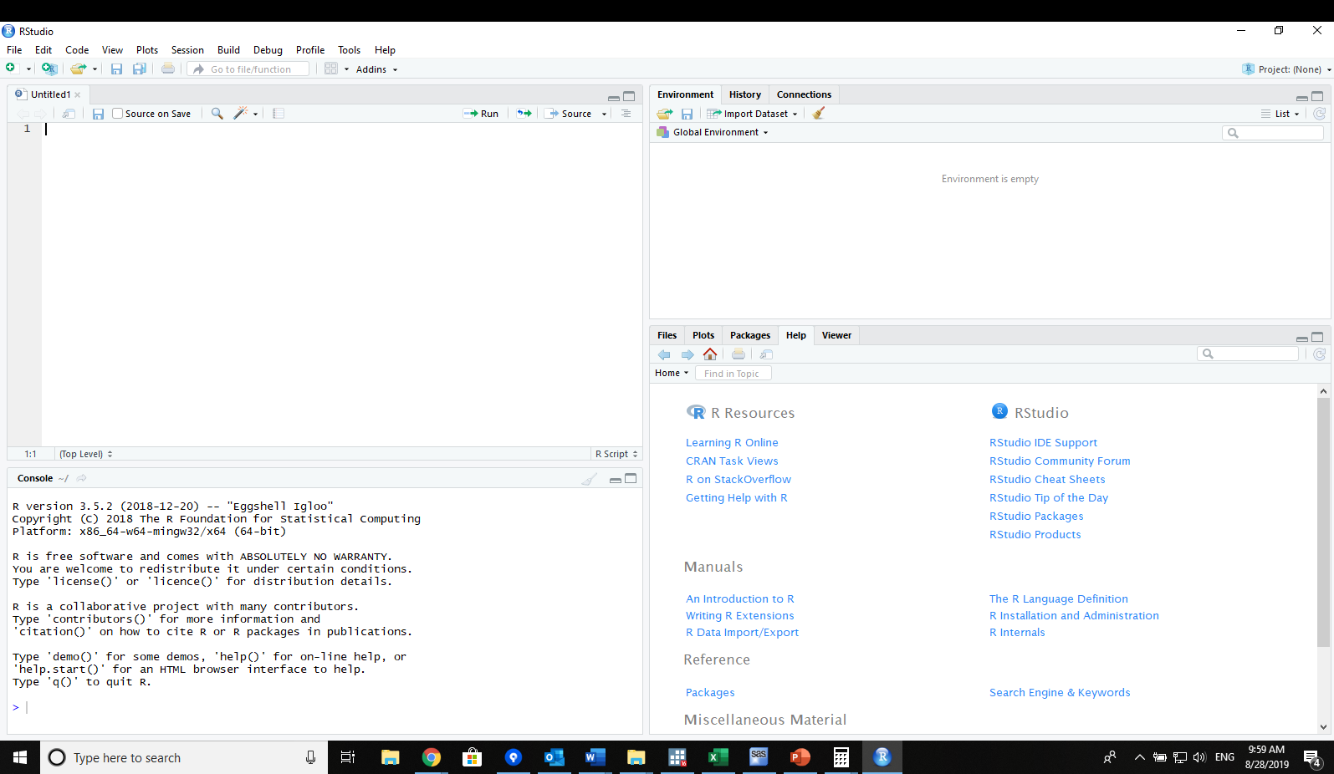
Main Rstudio Window
Open Rstudio (via icon on the desktop or Windows menu)
Drop downs and automatic buttons
Scripts
Environment, History, and connections tabs
divided into several sub-windows, each of which may have tabs
windows can re-sized as desired, colors can change etc…
Cursor only active in one pane
Multiple instances can run at same time
Files, plots, packages, help and viewer tabs
Command/console

Slide 6
Making Things Happen
Open Rstudio (via icon on the desktop or Windows menu)
Drop downs and automatic buttons
Scripts
Environment, History, and connections tabs
Commands can be submitted by typing into command prompt at console window and hitting Enter/Return
Commands can also be submitted through drop down menus (some)
History records all recent commands, and these can be reentered by using ‘Up arrow’ + enter or using history
Files, plots, packages, help and viewer tabs
Command/console

Slide 7
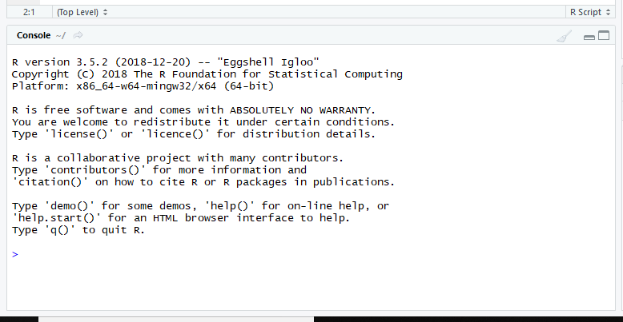
CONsole
Command prompt for entering commands `>’
Also shows returned results of commands
When > is shown the R console is ready for a new command
When ‘+’ is shown it is awaiting completion of a previous command

Slide 8
CONsole
Command prompt for entering commands `>’
Also shows returned results of commands
When > is shown the R console is ready for a new command
When ‘+’ is shown it is awaiting completion of a previous command
RED – errors and warnings
BLUE – echoed commands
BLACK = Printed results

Slide 9
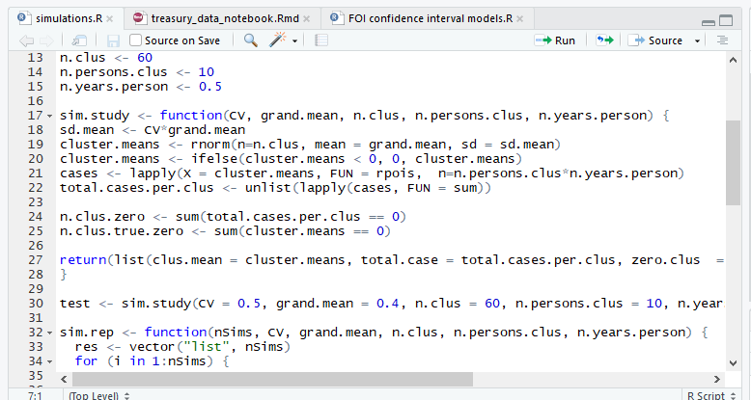
SCRIPTS PANEL
Code tools drop down
Rerun last chunk
Run current line or selection
Source or Source w/echo
filenames
Search/find
render
Text editor with code highlighting in ~20 languages.
Multiple tabs (thus multiple files) can be open at same time.
Code can be run or sourced from here script files edited, and breakpoints set for formal debugging of functions
Can also View data frames and other objects in this pane.
Outline
Line numbers, breakpoints, debugging
Steps, folds
Highlighting language

Slide 10
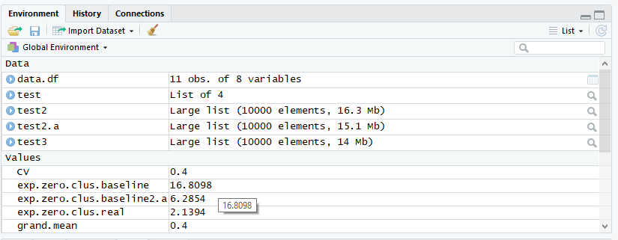
Env/Hist/Connect PANEL
Clear environment
Search environment
View object (works for some types)
Environment
/namespace
Three tabs:
Environment – shows objects available inside specific environments and namespaces
History – Shows command history
Connections – shows connections to external databases. We wont use this in this class.
Attributes viewers
Environment lists, data, values, functions and other object types
Shows global environment and namespaces of packages loaded

Slide 11
Env/Hist/Connect PANEL
Send command to source file that is active
Delete selected entries
Search history
Send command to console
Three tabs:
Environment – shows objects available inside specific environments and namespaces
History – Shows command history
Connections – shows connections to external databases. We wont use this in this class.
Also can send command to console by double click

Slide 12
Env/Hist/Connect PANEL
Three tabs:
Environment – shows objects available inside specific environments and namespaces
History – Shows command history
Connections – shows connections to external databases. We wont use this in this class.

Slide 13
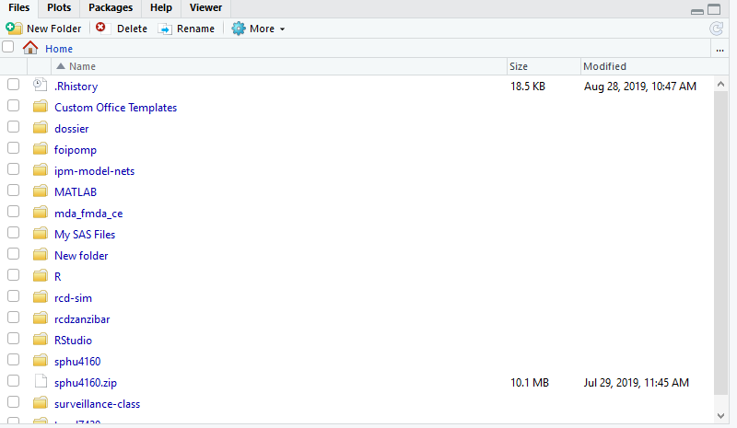
Files/Plots/Packages/help/Viewer pane
Five tabs:
Files – standard file explorer
Plots – charts, and history of charts
Packages – packages installed
Help – R interactive help
Viewer – shows local web content (we probably won’t use)

Slide 14
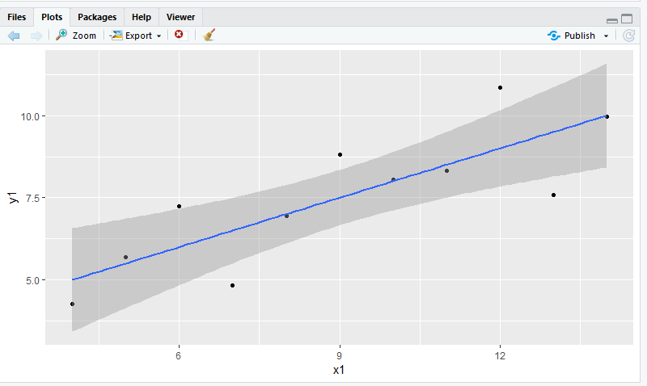
Files/Plots/Packages/help/Viewer pane
Save as specific file type
Publish through R specific web sharing sites
Five tabs:
Files – standard file explorer
Plots – charts, and history of charts
Packages – packages installed
Help – R interactive help
Viewer – shows local web content (we probably won’t use)

Slide 15
Files/Plots/Packages/help/Viewer pane
Install new packages
Update selected packages
Package name, library loaded tick box
Five tabs:
Files – standard file explorer
Plots – charts, and history of charts
Packages – packages installed
Help – R interactive help
Viewer – shows local web content (we probably won’t use)
Package description
Package version

Slide 16
Files/Plots/Packages/help/Viewer pane
function name
Function package
Search in help file and help history
Short function description
Five tabs:
Files – standard file explorer
Plots – charts, and history of charts
Packages – packages installed
Help – R interactive help
Viewer – shows local web content (we probably won’t use)
More detailed description
Function syntax
Names of function arguments
Descriptions of function arguments

Slide 17
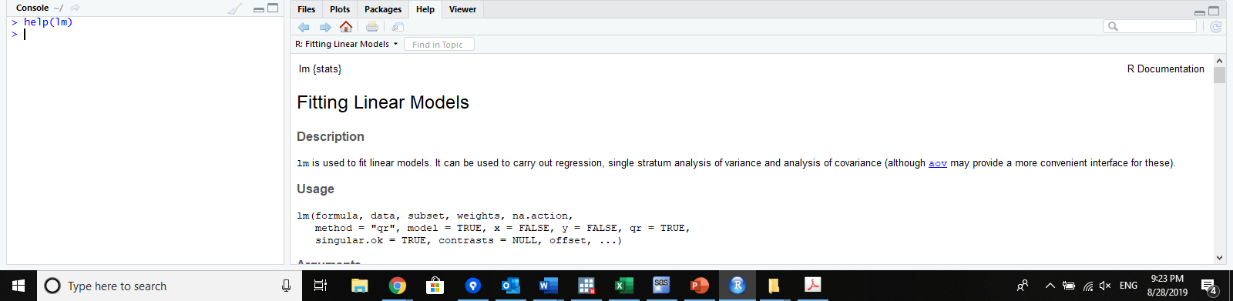
Getting HELP! (first introduction to an R Function)
Many ways to get R help –
1) type help() – this gives you help for the help function.
II) type help(topic) see above for help(lm) which gives the help file for fitting a linear model
This approach works only if you know the specific function or topic you are looking for

Slide 18
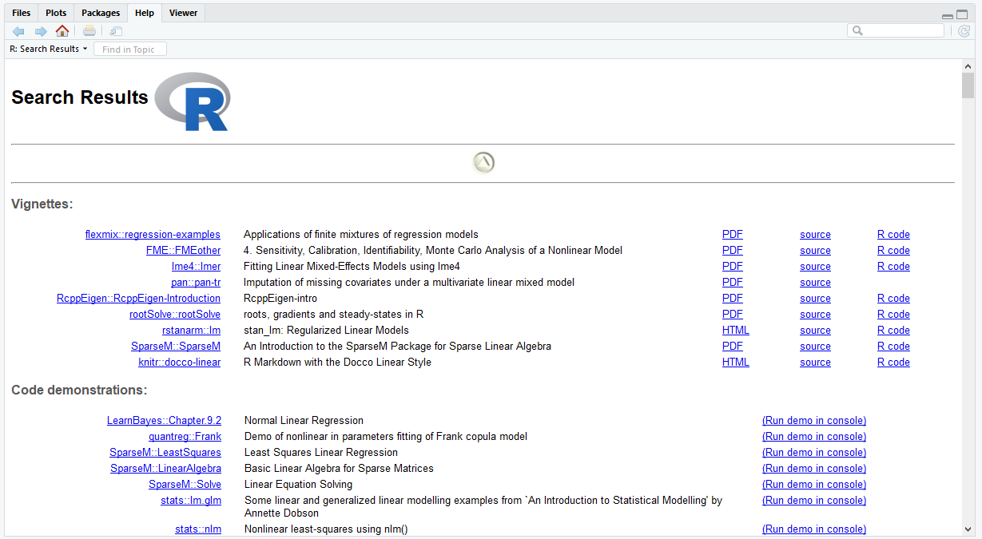
Getting HELP! (first introduction to an R Function)
Many ways to get R help –
III) type ??keyword/search string
This function is actually complex, but simply it does a much wider search through R help.
IV) help on a specific package help(package=“PackageName”)

Slide 19
Getting HELP! (first introduction to an R Function)
Many ways to get R help –
V) type ??keyword/search string
This function is actually complex, but simply it does a much wider search through R help not looking exact matches but matches that include search string.
IV) https://www.r-project.org/help.html contains a pretty good, though over complicated summary of options

Slide 20
Getting HELP!
Help menu
Gives you R studio specific help including some basic training

Slide 21
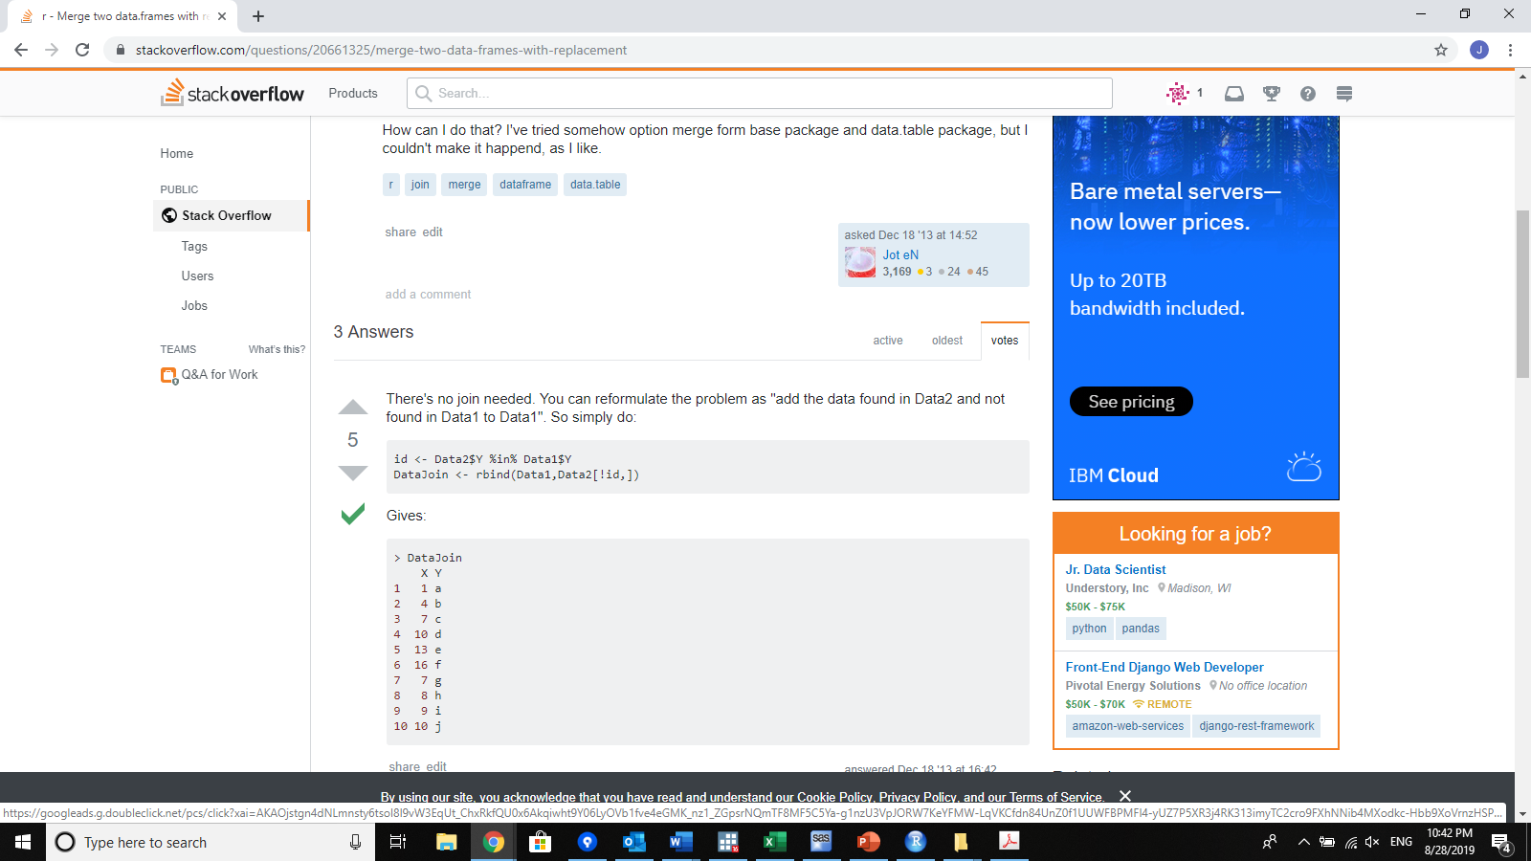
Getting HELP!
StackOverflow – public question and answer site.
https://stackoverflow.com/questions/tagged/r
Over 300k R questions as of last night
Often you don’t even need to ask, just search for your question and find the answer

Slide 22
Getting HELP!
StackOverflow – public question and answer site.
Users submit questions, other users submit answers and yet other uses can vote positively or negatively on answers and on questions
The idea of course that the most useful and well formulated questions get upvotes and the best answers too

Slide 23
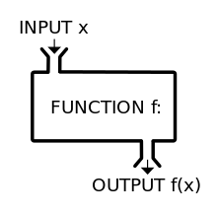
The R function
R is essentially a functional programming language
Most everything one does is through the use of functions
These are very similar to mathematical functions
i.e. f(x) = x + 2x
Essentially all commands in r are functions and most look something like
functionname(argument1, argument2,….)
as we mentioned already help()
It’s the function help() and takes a few arguments, but all have defaults except for the argument for topic

Slide 24
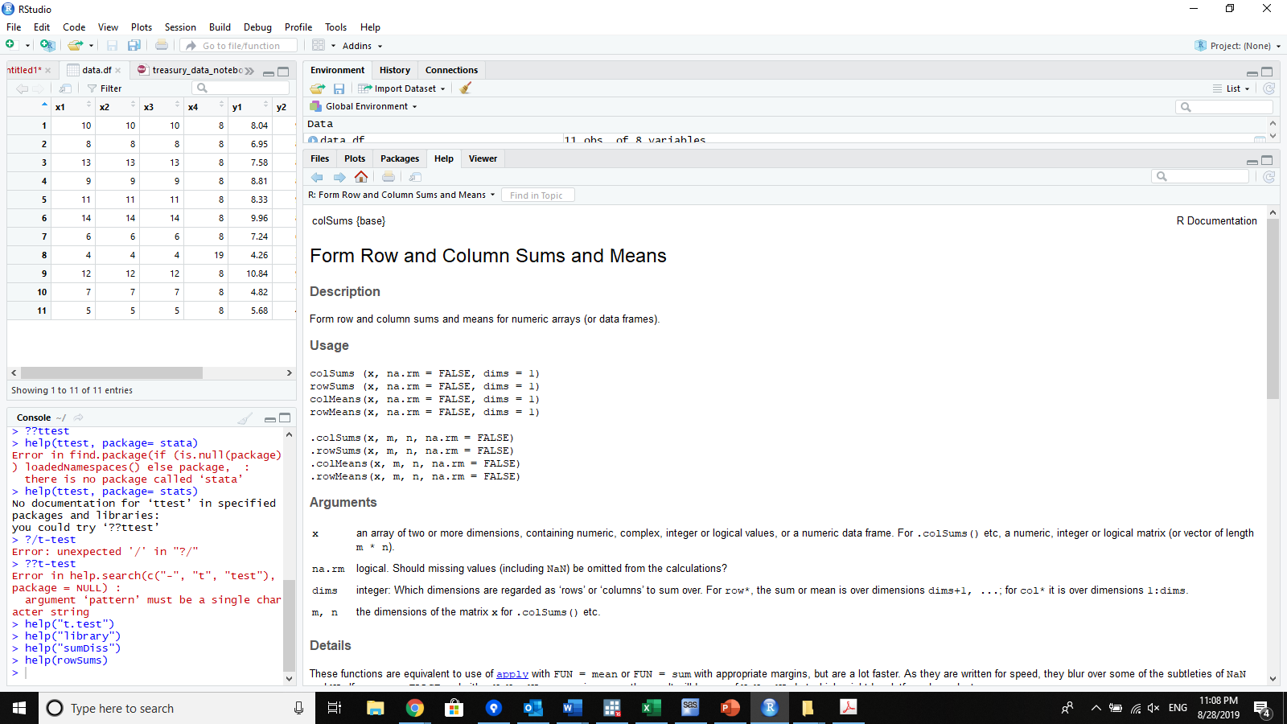
The R function
R is essentially a functional programming language
Most everything one does is through the use of functions
These are very similar to mathematical functions
How does R interpret a function
colSums above from a help file… colSums() is the basic function call.
It takes three arguments. X, na.rm, and dims.
The first one has no default but the second and third default to FALSE and 1 respectively.

Slide 25
Functional Programming
Pure functions –
Only one possible result from same arguments
Don’t change anything in the global environment (unless specifically returned) don’t produce side-effects. (i.e. are local in scope)
Random number using functions and reading from files are not pure.
Immutability – objects don’t change, (true of most R objects) what looks like changing them is actually re-creating or overwriting a copy of them.
Referential Transparency – Not to worry about this here
Purity + Immutability = Function + Arguments can be replaced by its own unique return.
Functions are first class
They are treated like scalars, or other data hence:
They can be passed to other functions
They can be generated by other functions
They can be assigned to named objects
They can be stored in any data structure
Pure functions
Immutability
Referential transparency
Functions as first-class entities

Slide 26
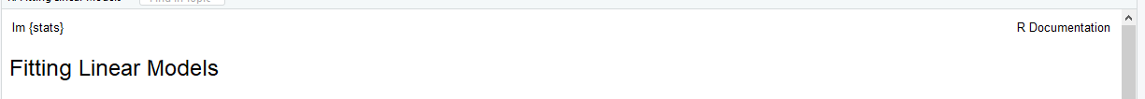
Anatomy of A Help FILE
Header gives function name, and package name and short description of function
Here we use lm as the example. It is a linear model fitting function, in other words basic regression
Sections –
Header
Description
Usage
Arguments
Details
Value
See Also
Examples

Slide 27
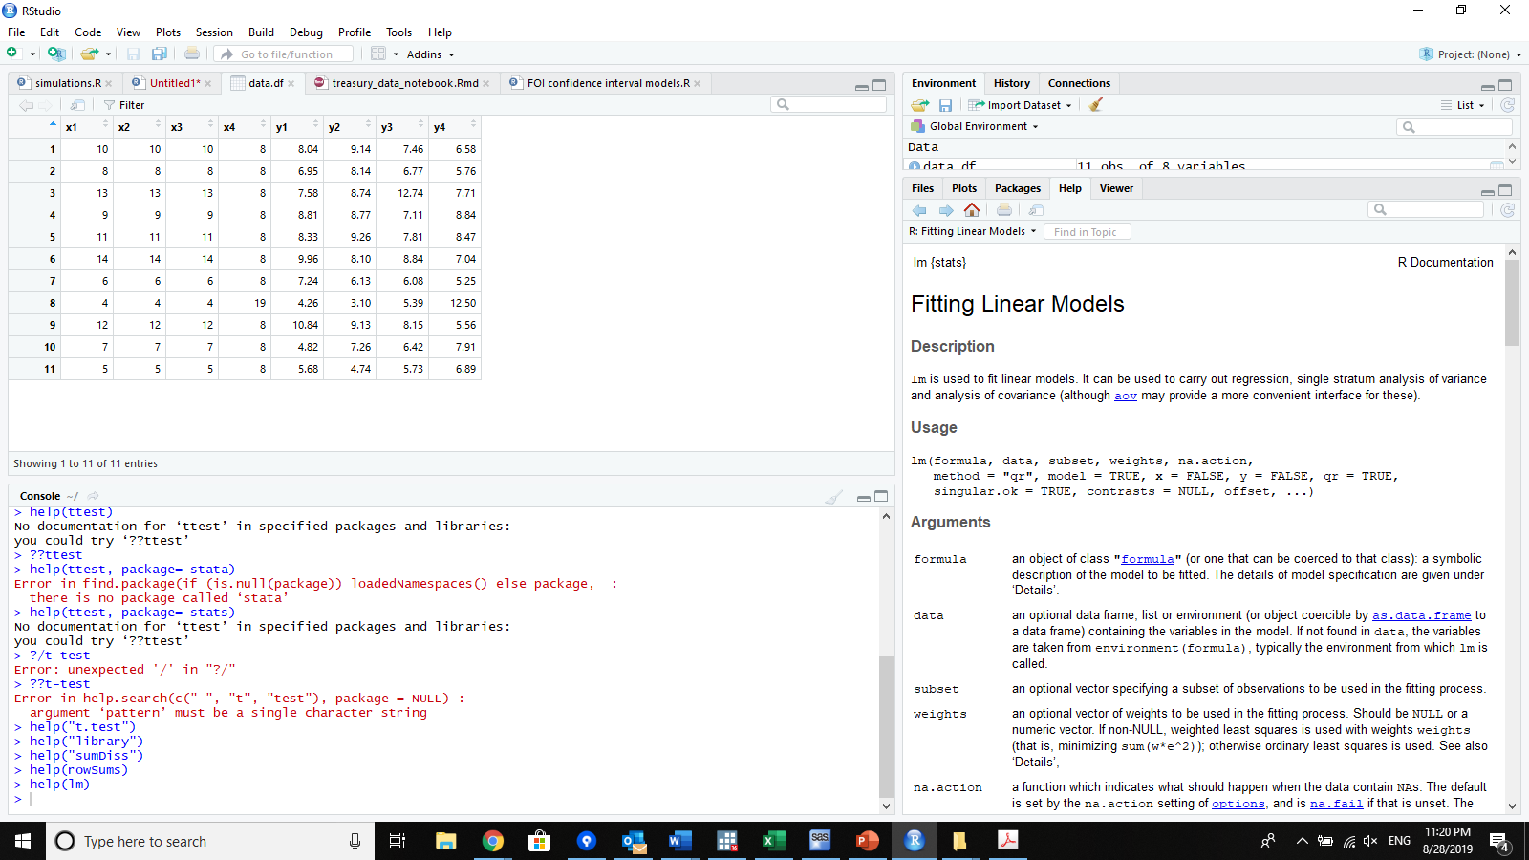
Anatomy of A Help FILE
Sections –
Header
Description
Usage
Arguments
Details
Value
See Also
Examples
Description gives a detailed description of the purpose of the function and perhaps how it works.

Slide 28
Anatomy of A Help FILE
Sections –
Header
Description
Usage
Arguments
Details
Value
See Also
Examples
Usage is the real syntax
Functionname(arguments)
Here the first argument is ‘formula’. It has no default
The second is ‘data’ etc..
All arguments are usually needed, but often they have defaults. These are shown in help by having the argument = something
For instance here the sixth argument is method = “qr”
Thus when this function is called if there is no method argument given it will automatically default to “qr”

Slide 29
Anatomy of A Help FILE
Sections –
Header
Description
Usage
Arguments
Details
Value
See Also
Examples
Arguments give details of what input to each argument.
Pay careful attention to na.action or na.remove as options as its always a concern how missing data are handled.

Slide 30
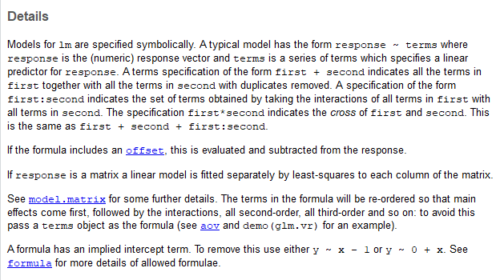
Anatomy of A Help FILE
Sections –
Header
Description
Usage
Arguments
Details
Value
See Also
Examples
Details are expansive (sometimes) notes on quirks or specific information about the function, how it works, why or anything else the authors feel is necessary or informative to users.

Slide 31
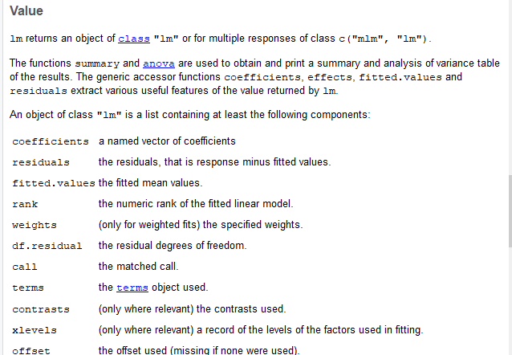
Anatomy of A Help FILE
Sections –
Header
Description
Usage
Arguments
Details
Value
See Also
Examples
Value gives what the function returns - sometimes this is very complicated (as in the case of lm) and sometimes pretty simple. e.g. for sum the Value is The sum.

Slide 32
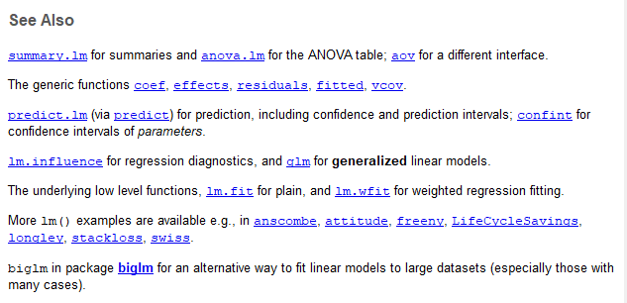
Anatomy of A Help FILE
Sections –
Header
Description
Usage
Arguments
Details
Value
See Also
Examples
See also is pretty self explanatory

Slide 33
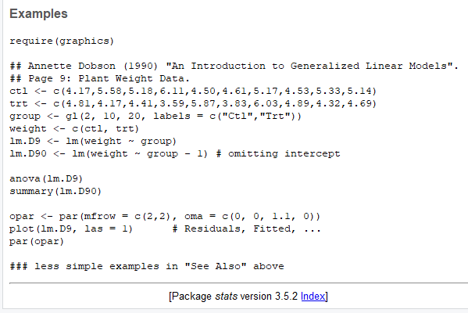
Anatomy of A Help FILE
Sections –
Header
Description
Usage
Arguments
Details
Value
See Also
Examples
Examples give executable code that show the use cases for the function.
Their helpfulness for learning purposes vary greatly

Slide 34
Anatomy of A Help FILE
Sections –
Header
Description
Usage
Arguments
Details
Value
See Also
Examples
Examples give executable code that show the use cases for the function.
Their helpfulness for learning purposes vary greatly

Slide 35
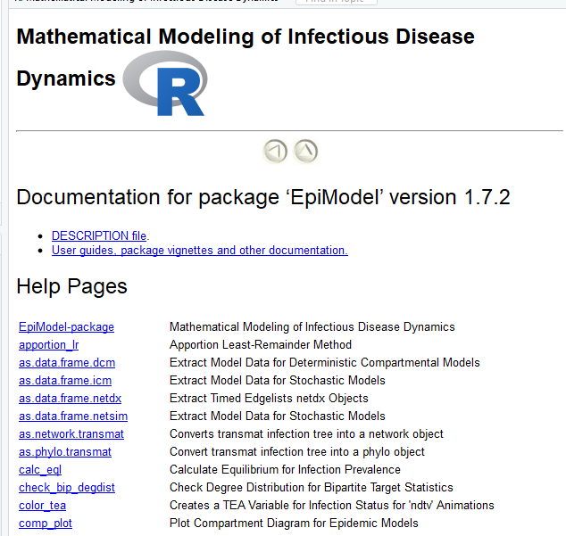
Package index
Links to all functions in the package
Description
As well as package user guides, demos and vignettes

